Slide 1

Playing games via gestures
PAC-MAN
By: Mark Dingli

Slide 2
OVERVIEW
01.
02.
03.
Introduction
Tools used
Implementation
04.
05.
06.
Challenges Faced
Results and Evaluation
Conclusion
Brief introduction for the Gesture Controlled Game.
Highlighting the tools used for the project.
Walking through the creation of the AI-enhanced game.
Sharing the hurdles that were encountered.
Showcasing the game's performance and design.
Reflecting on insights gained and the project's impact.

Slide 3
01.
Introduction
Brief introduction for the Gesture Controlled Game.

Slide 4
Introduction
The project revolves around enhancing the traditional Pac-Man game experience by infusing artificial intelligence and gesture-based controls. Leveraging the power of AI, a model is trained to interpret unique hand movements, subsequently guiding the in-game Pac-Man character. The motivation behind this endeavour is to explore innovative ways to enrich gaming experiences, merging a classic with advanced technology to deliver a unique and engaging form of interactive entertainment.

Slide 5
02.
Tools used
Highlighting the tools used for the project.

Slide 6

TOOLS USED
TEACHEABLE MACHINE
The cornerstone of this project is Google's Teachable Machine, an intuitive tool that allows for easy training of machine learning models using image data. This tool allowed me to capture the hand gestures representing the different movement directions, which were ultimately sued as the game’s controls.
This JavaScript library offered the necessary functionality to create an interactive game canvas, draw game elements, and process the webcam feed. The p5.js library played a pivotal role in capturing the user's gestures in real-time and feeding this data into the Teachable Machine model for real-time gesture classification.

Slide 7
03.
Implementation
Walking through the creation of the AI-enhanced game.

Slide 8
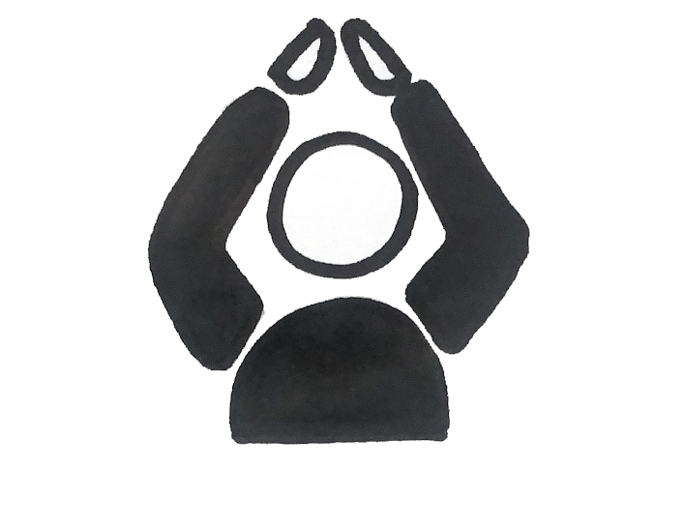
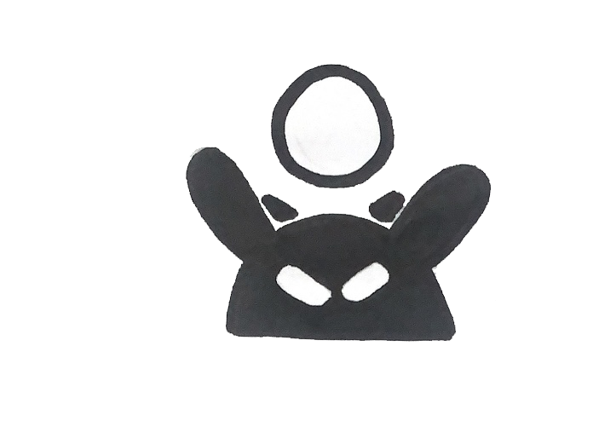



Training the model
The transformation of the classic Pac-Man game into an AI-enhanced, gesture-controlled gaming experience unfolded through a series of carefully planned stages during the implementation phase of this project. The process started with the generation of a machine learning model utilizing Google's Teachable Machine. Various hand gestures representing directions (up, down, left, right & nothing) were captured in multiple positions and under different lighting conditions to train the model. Once trained, the model's performance was put to the test, testing its accuracy and real-time responsiveness to gestures.
up
down
left
right
nothing

Slide 9






Integrating the model
Using the p5.js JavaScript library, an interactive canvas was created to host the game elements. This library provided a suite of tools necessary to create the game environment, animate game characters, and facilitate real-time interactivity.
The next crucial step was to integrate the trained AI model. To achieve this, a real-time feed from the user's webcam was implemented on the game screen. The captured hand gestures were then continuously fed into the AI model, and in return, the model provided a classified output corresponding to each specific gesture. This classified output was used to control the movement of Pac-Man on the game canvas.
To enhance user experience dynamic hand gesture images are displayed to the left, changing in sync with the player's movements. This real-time visual feedback gives players an understanding of the gesture being recognized by the AI, hence providing an intuitive and interactive gaming experience.
up
down
left
right
nothing

Slide 10

Building the WEB APPLICATION
To ensure the game was easily accessible, the application was designed as a web-based platform. The application interface was designed with three main sections - the menu page, instructions page, and the game page.
The web application was designed using modern web technologies, prioritizing a user-friendly and intuitive interface. HTML5 and CSS3 were utilized for structuring and styling the web interface, ensuring a visually appealing and responsive design.
JavaScript, specifically the p5.js library, was further employed to enable the interactivity within the game and to maintain a smooth, real-time gameplay experience. By leveraging these technologies, the game could be embedded directly into the web page, providing a seamless user experience.
In addition, accessibility and usability were key considerations in the design process. The aim was to make the game as inclusive and straightforward as possible, so users of all abilities and levels could enjoy the AI-powered Pac-Man game.

Slide 11
04.
Challenges Faced
Sharing the hurdles that were encountered.

Slide 12
Challenges Faced
model Training and Integration
Web Application Design & Real-Time Processing
Testing and Debugging
Achieving accurate hand gesture recognition via AI required iterative model tuning and integration into the game was complex.
Developing an intuitive, user-friendly application while maintaining swift real-time gameplay was a significant multi-layered challenge.
Continuous bug identification and rectification, particularly during AI integration, were essential to ensure optimal game performance.

Slide 13
limitations
Variations in environment, including lighting and background, impact gesture recognition.
Camera quality significantly influences gesture recognition accuracy.
A pause during AI model loading could be improved for a smoother user experience.
Game design, especially the behaviour of the ghosts, could be enhanced for more challenging gameplay.

Slide 14
05.
Results and Evaluation
Showcasing the game's performance and design.

Slide 15
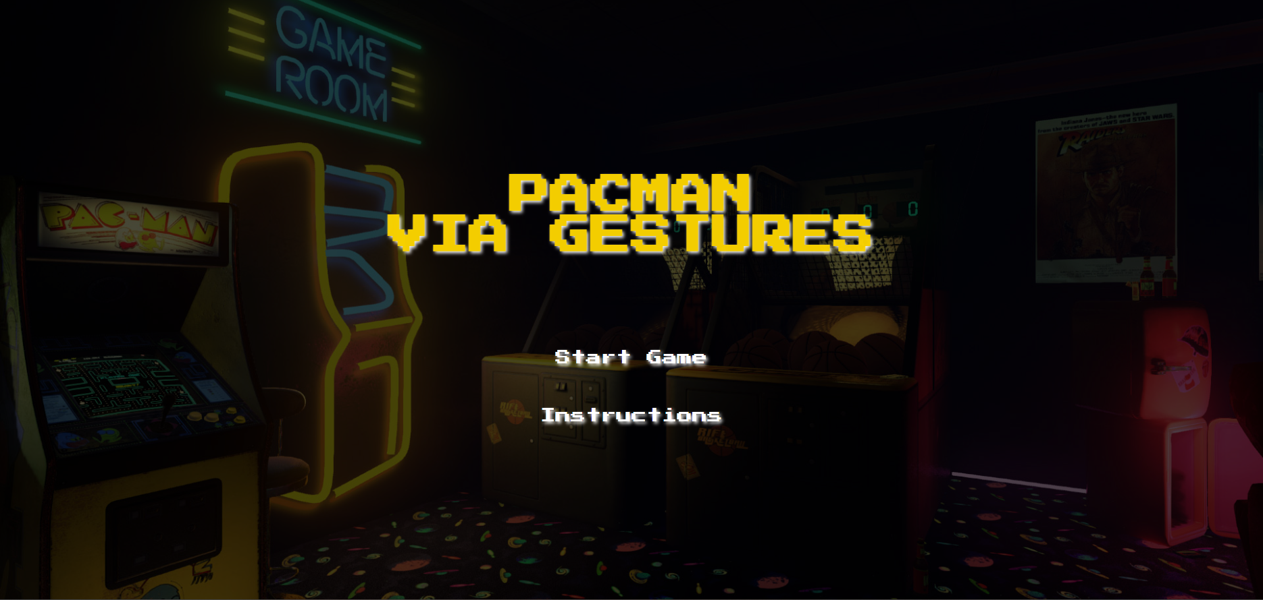
Menu page

Slide 16
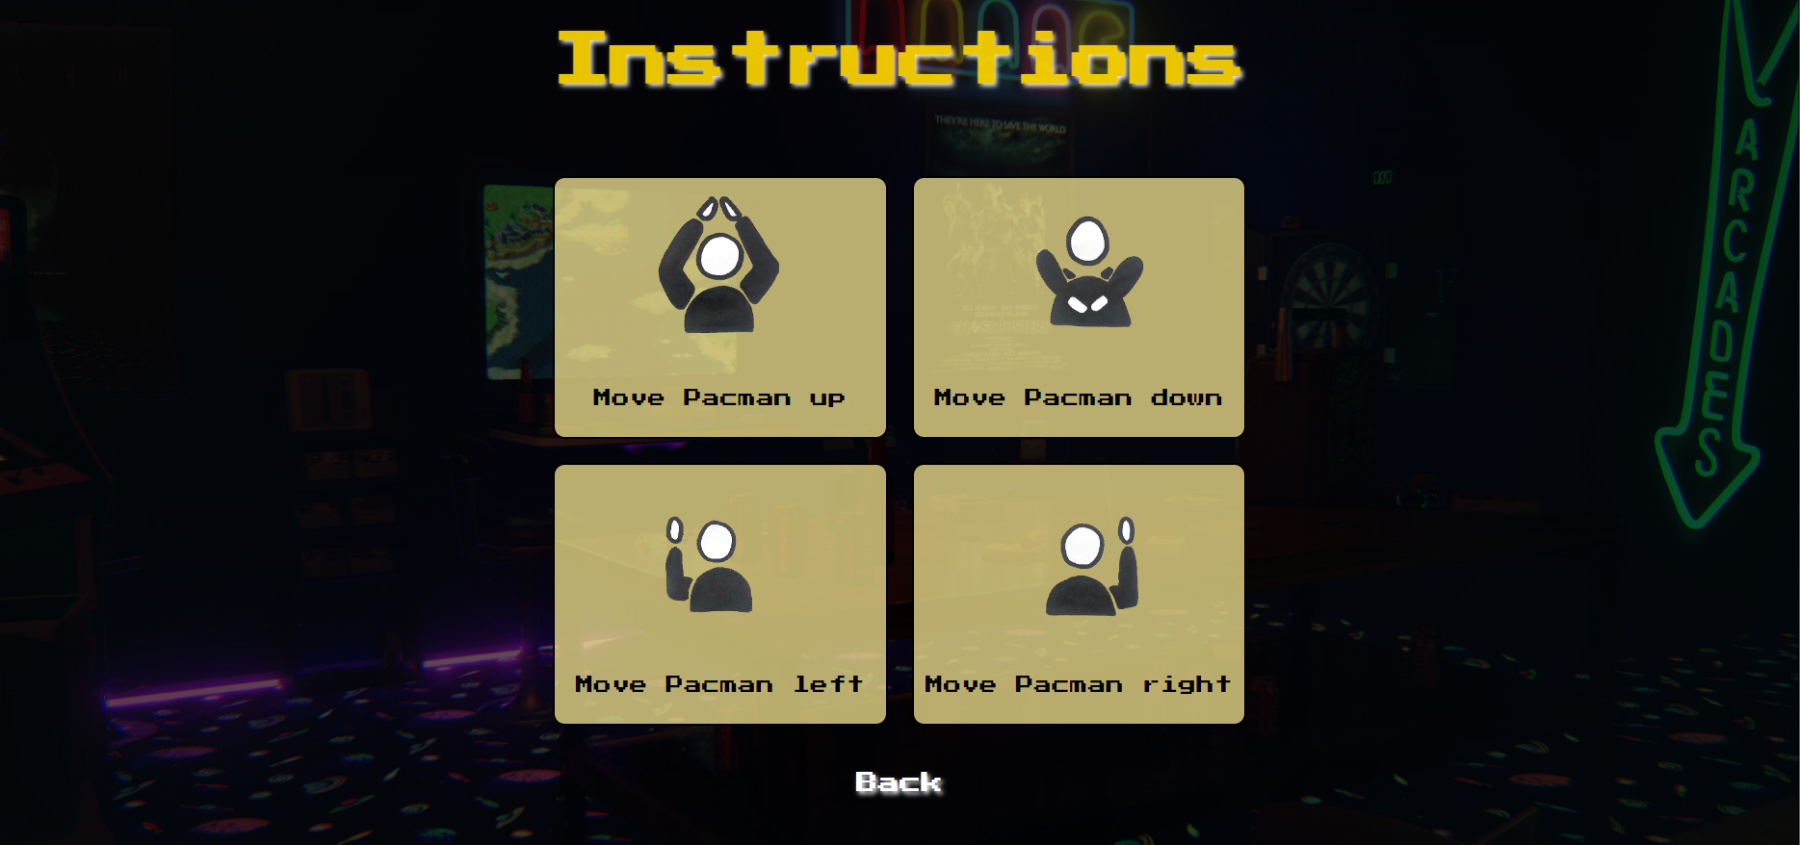
instructions page

Slide 17
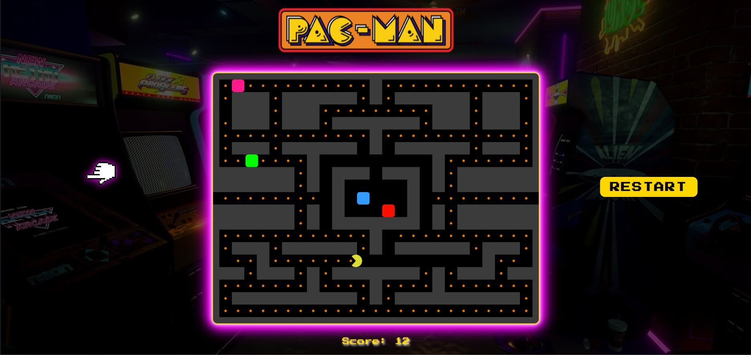
Game page

Slide 18
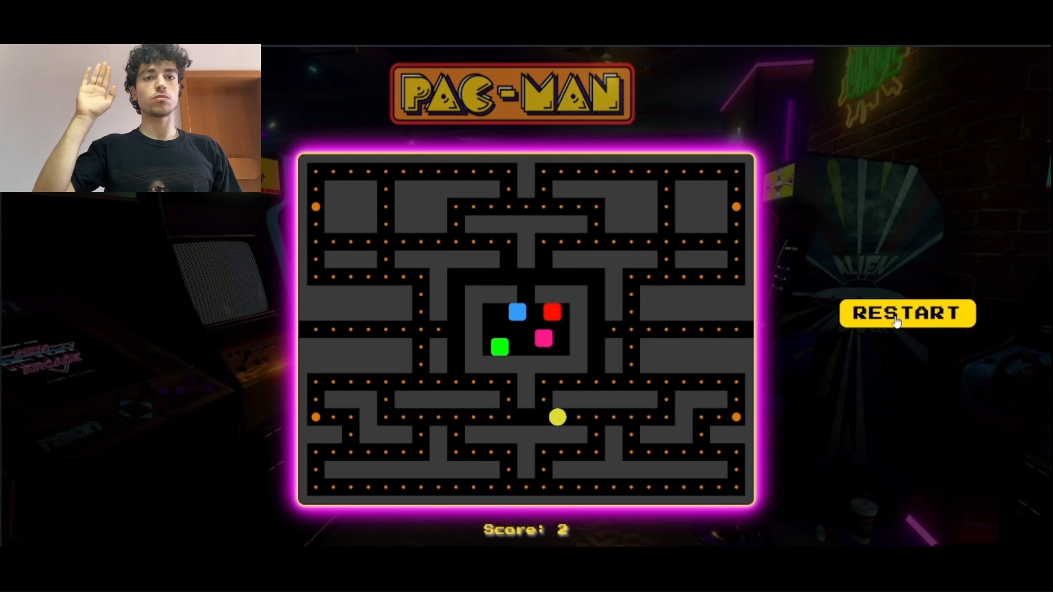
Video gameplay

Slide 19
06.
conclusion
Reflecting on insights gained and the project's impact.

Slide 20


What was learnt
Iteration is Key
Integrating Ideas
Future of Gaming
Continuous testing and improvements are pivotal in refining the final product.
Deepened understanding and successful integration of various technologies was key in this project.
AI's potential in enhancing gaming interactivity was explored, highlighting future developments.

Slide 21

conclusion
This project brought together classic gaming and modern AI, creating a unique hand-gesture controlled Pac-Man game. It showed how AI can make games more immersive and taught me valuable lessons in tackling complex challenges. The project underlines AI's vast potential for transforming digital interactivity across many fields.

Slide 22


Thank you!

